Slide 1

Music Store Data Analysis

Slide 2

1) INSIGHTS

Slide 3
1) Who is the senior most employee, find name and job title.
Senior most employee is Mohan Madan (Senior General Manager)
Number of employees are more at junior level and as the seniority level increases number of employees decreases.

Slide 4
2) Which countries have the most Invoices?
It is clearly seen from the pivot table that more the number of countries more will the number of invoices.
Maximum countries are from Europe only.
Europe is on the top in terms of invoices generated ,instead of this, other countries of Europe fail to be top in terms of invoices generated [Top country is of North America (USA)].
USA played a major role in terms of invoices invoice generated in North America.

Slide 5
3) What are top 3 values of total invoice?
Top 3 values of total invoice contain 2 Countries (France & Canada).

Slide 6
4) Cities with top customers
These are the cities in terms of maximum total invoice.
So for organizing a promotional music festival , these cities can generate good revenues.

Slide 7
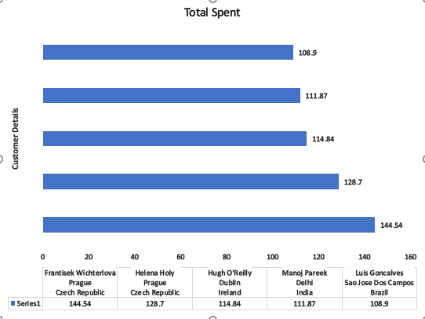
5) Top 5 Customers In terms Of Total Money They Spend.

Slide 8
6) Most Popular Music Genre For Each Country In Terms Of Purchase
Rock is the only music genre which is popular in all country except Argentina.

Slide 9
7) TOP 10 Artist Who Have Written The Most Rock Music

Slide 10
9) Amount Spend By Customer On Artist (TOP 5 Customers)

Slide 11
10) Customer Spend Most On Music (TOP 5 Customers)

Slide 12
2) Conclusions
Number of employees are less at senior level as compared to junior level.
Maximum countries(where customers belongs) are from Europe ( ~70%).
Maximum total invoice amount is from Prague city also top two customers in terms of money they spend belongs to this city.
Rock is the only music genre which is popular in all country except Argentina in terms of purchase.
U2 is the artist who has written the most rock music

Slide 13
THANK YOU

